Slide 1
W261 Final Project
Team 10
Youzhi (Chloe) Wu, Chun-Jen (Curtis) Lin, Eddie Zhu, Kai Qi Lim

Slide 2
Outline
Introduction & Objective
EDA
Algorithm explanation and implementation
Feature engineering
Running the full dataset
Application of course concepts

Slide 3
Marketing costs money...
Our objective is:
To analyze the features of an ad
To predict if an ad would be clicked
To help increase ad click through rate (CTR)
To eventually, establish a targeted and effective marketing strategy

Slide 4
EDA
Notes:
Disclaimer: our EDA is not conducted on full dataset. It is conducted on 4 randomly sampled toy datasets. One with 1,000 records; the other three each with 10,000 records.

Slide 5
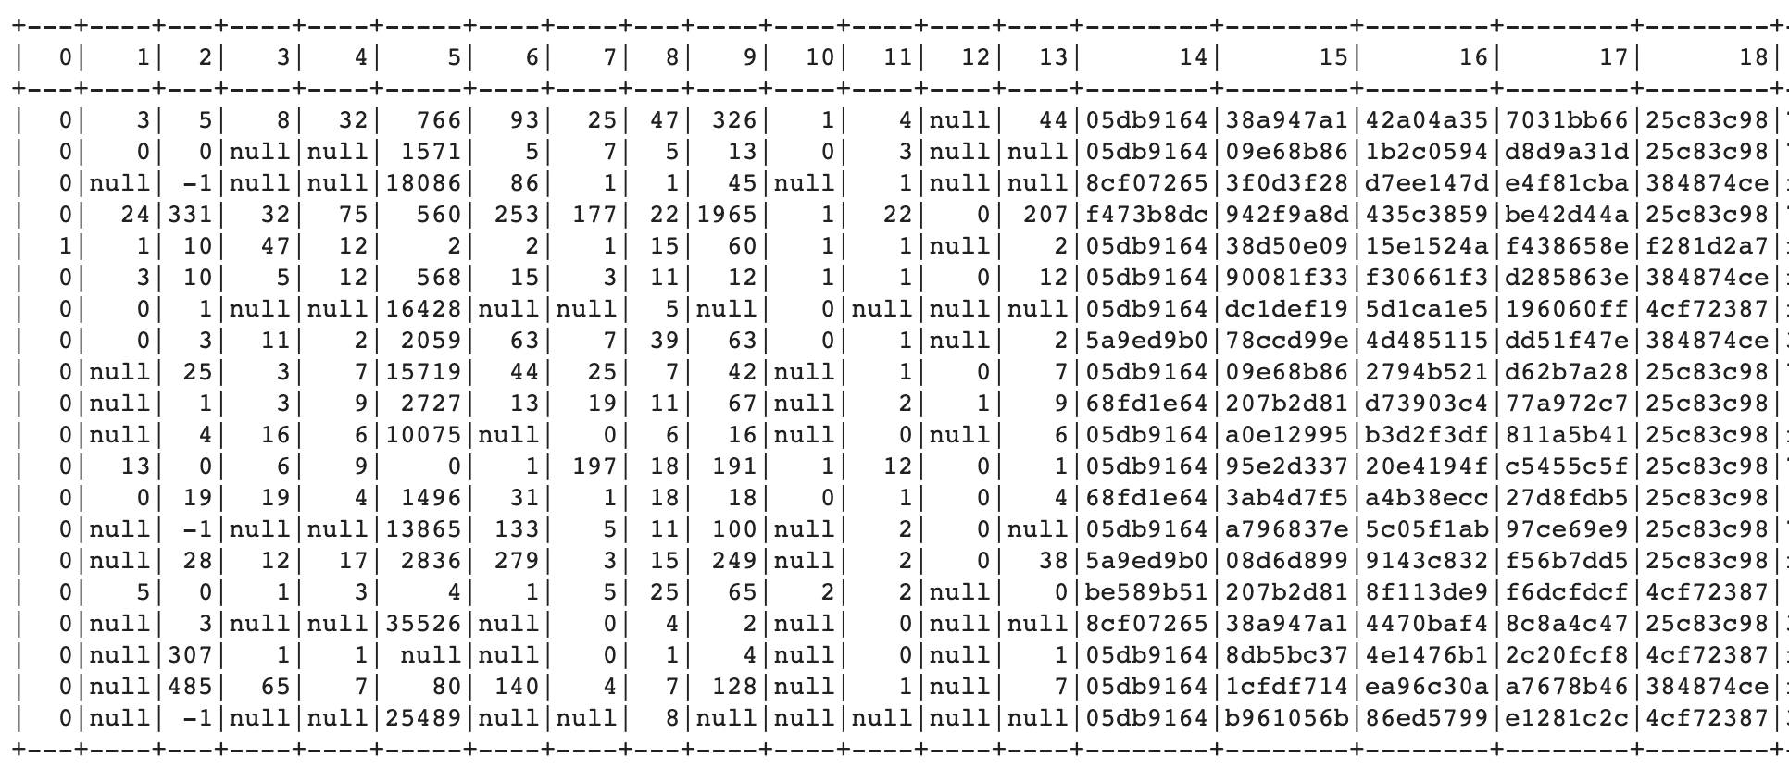
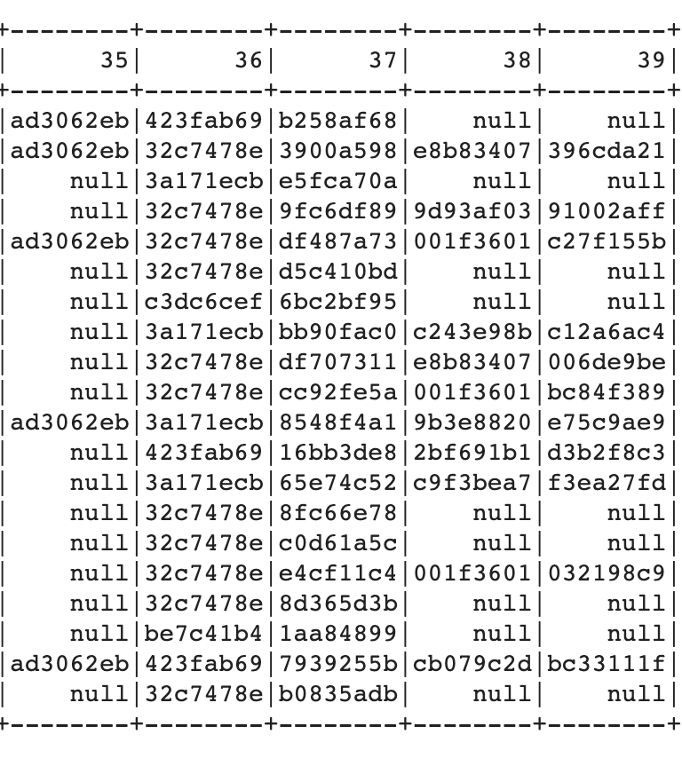
First look at raw data
...
...
Target
13 numeric variables
26 categorical variables

Slide 6
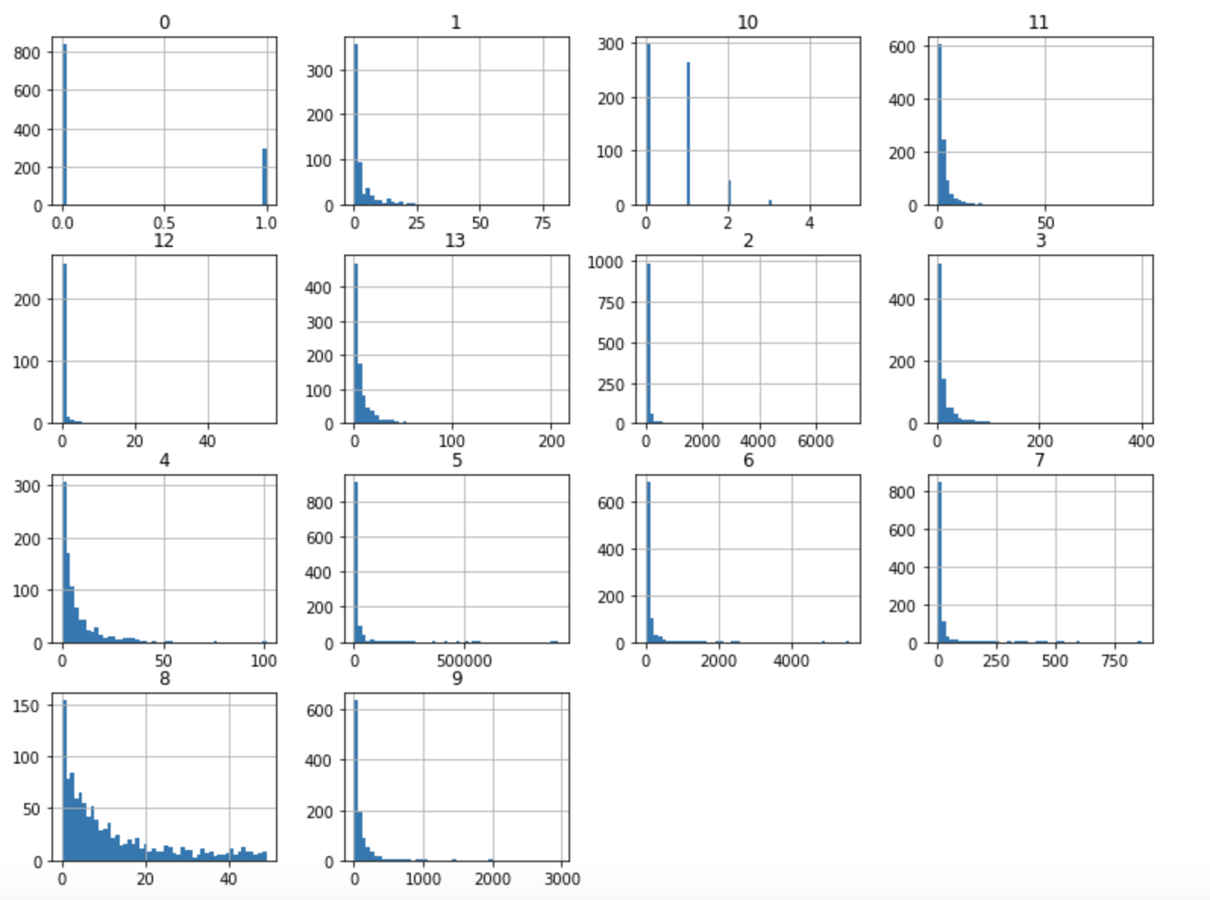
Histograms for Numeric Variables
Notes:
Skewness
Scale at different magnitude

Slide 7
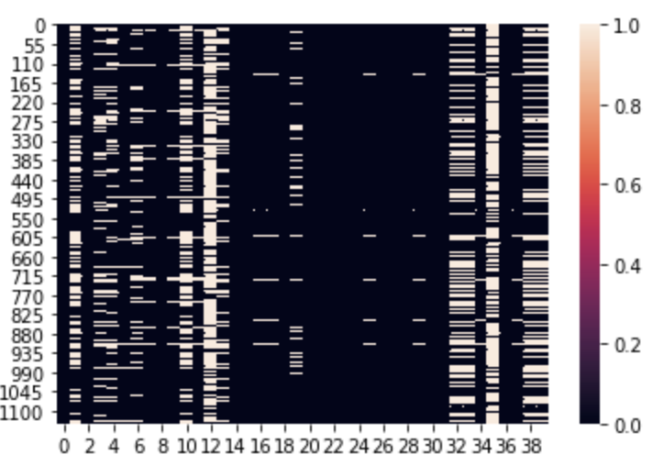
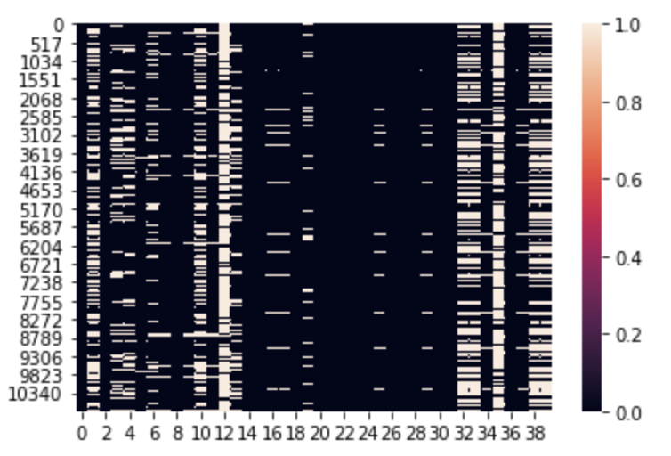
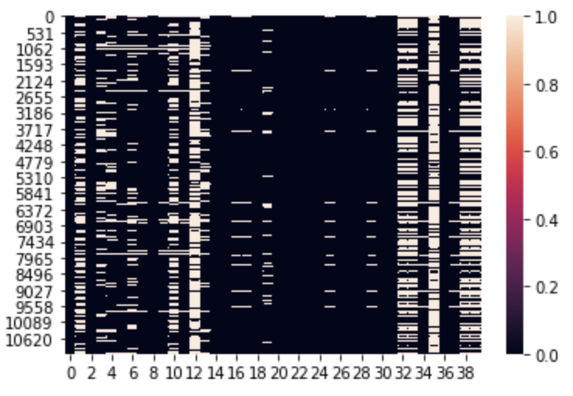
Heatmaps
To compare similarity
Notes:
The following columns tend to be null in the same rows:
Col 1, 10
Col 3, 4, 6, 13
Col 7, 9, 11
Col 16, 17, 25 and 29
Col 32, 33, 38, 39
Col 12, 35: for these two columns, half of the rows are empty. Which bring up a question on whether they would be useful for prediction. We may need to consider removing these 2 features from our model.

Slide 8
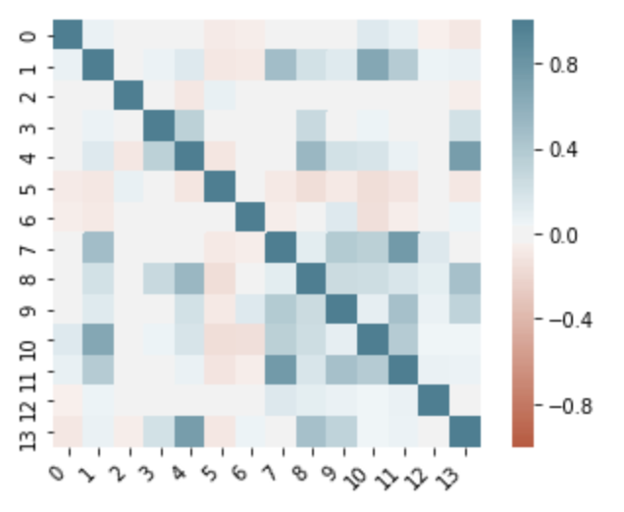
Correlation Heatmap
Strong positive correlation:
Column 1 and 10
Column 7 and 11
Column 4 and 13

Slide 9
Algorithm Explanation

Slide 10
Model selection
Binary target variable
Numeric variables
Categorical variables
Logistic Regression

Slide 11
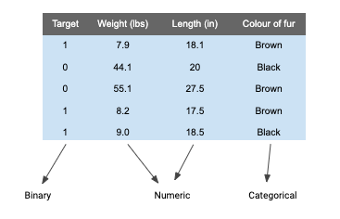


Mini toy dataset
Logistic regression
Weight (lbs)
x₁
θ₁
Length (in)
x₂
θ₂
Fur_brown
x₃
θ₃
Fur_black
x₃
θ₄

Slide 12
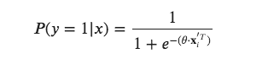
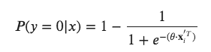
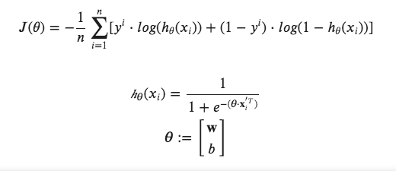
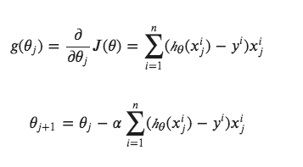
Logistic Regression
Probability that the animal is cat:
Probability that the animal is dog:
Log loss as cost function:
Gradient Descent:

Slide 13
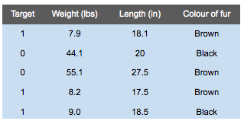
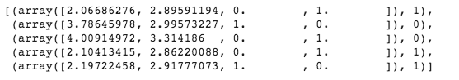
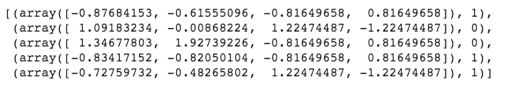
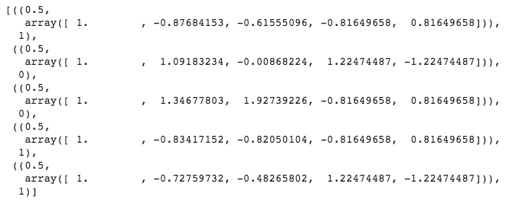
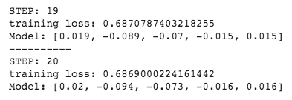
Implementation
parse
onehot
normalize
AugmentRDD
LGRDFit
AugmentRDD
GDUpdate
LRLoss

Slide 14
Feature Engineering

Slide 15
Flow of feature engineering
RDD
Fill null with mean value
(numeric variables)
Spark dataframe
One-hot encoding
(categorical variables)
Drop columns with > 50% missing value or uniqueness
Standard normalization
(categorical variables)
log(x+1) transformation
(numeric variables)
Standard normalization
(log-transformed numeric variables)
Fill null with mean value
(numeric variables)
PCA
(100 features)

Slide 16
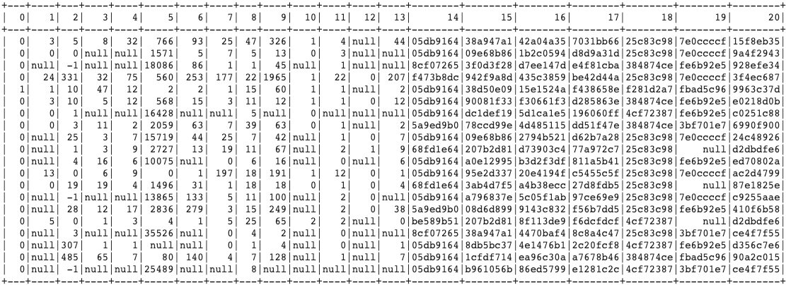
RDD to Spark dataframe
Total 40 columns

Slide 17
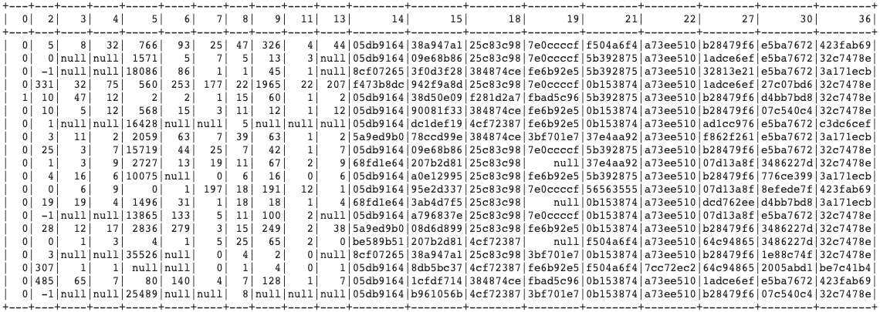
Drop columns with > 50% null or uniqueness
Columns with > 50% null value: '1', '10', '12', '32', '33', '35', '38', '39'
Columns with > 50% uniqueness: '16', '17', '20', '23', '24', '25', '26', '28', '29', '31', '34', '37'

Slide 18
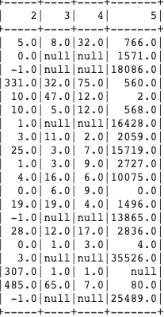
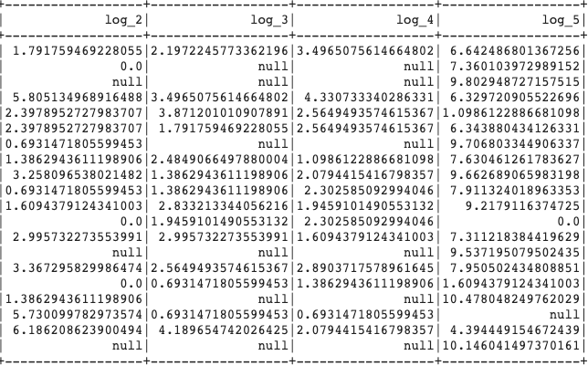
Log(x+1) transformation (numeric)

Slide 19
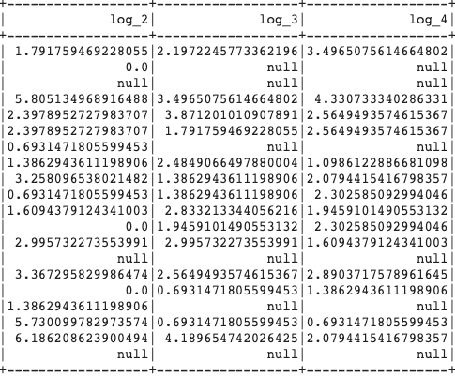
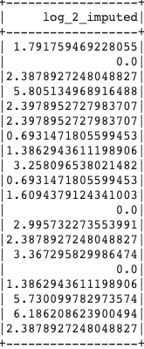
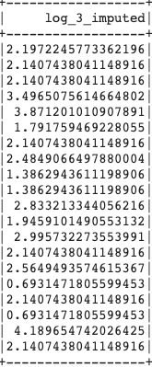
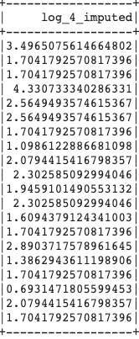
Fill null with mean (numeric)

Slide 20
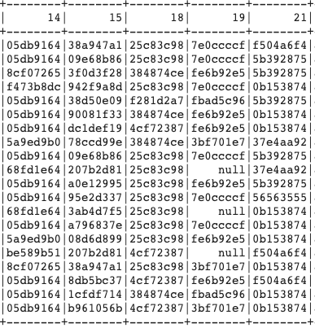
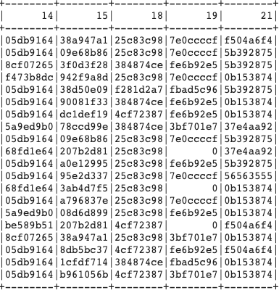
Fill null with zero for (categorical)

Slide 21
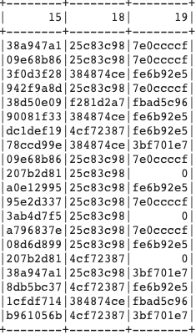
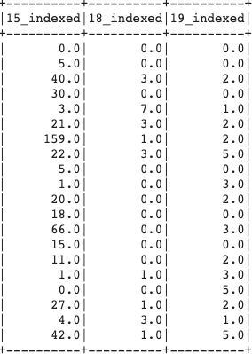
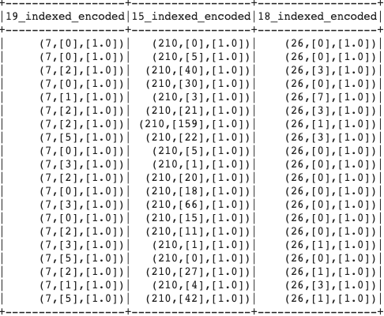
One-hot encoding (categorical)

Slide 22
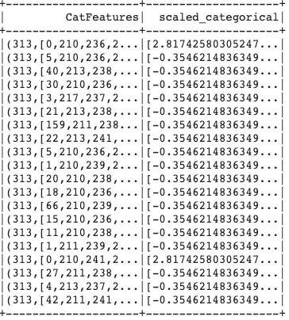
Standard normalization (categorical)

Slide 23
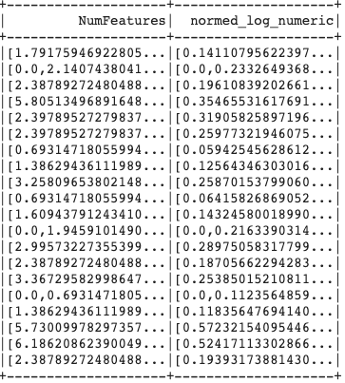
Standard normalization (numeric)

Slide 24
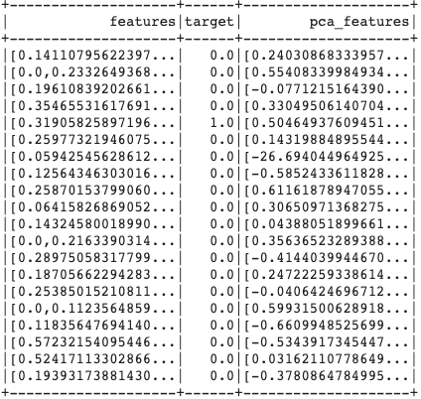
Principal component analysis (PCA)

Slide 25
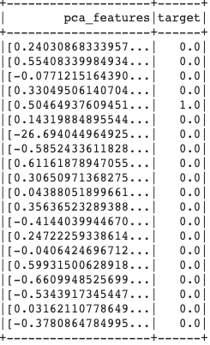
Final dataframe for logistic regression

Slide 26
Logistic regression in
small and middle scale

Slide 27
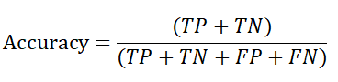
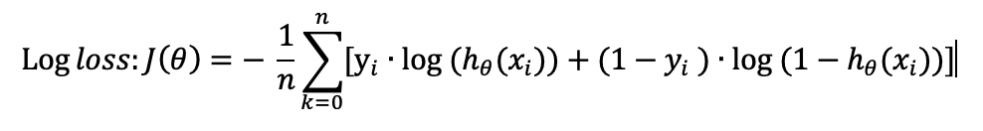
Statistical methods of model evaluation
Prediction Accuracy
Log loss

Slide 28
Small scale (~1000 row of data)
1136
row of data
910
row of data
(training, 80%)
Prediction accuracy: 0.743
Log loss: 0.739
split
226
row of data
(testing, 20%)

Slide 29
Middle scale (~10000 row of data)
10849
row of data
(training)
11131
row of data
(testing)
Prediction accuracy: 0.727
Log loss: 0.619

Slide 30
Running the full dataset & GCP

Slide 31
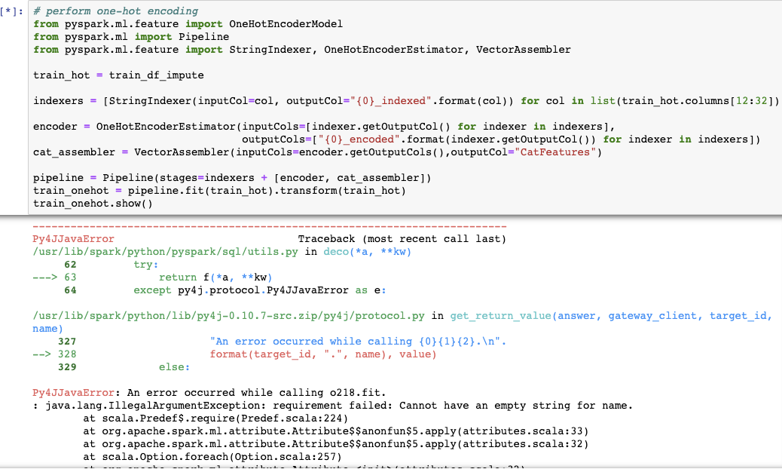
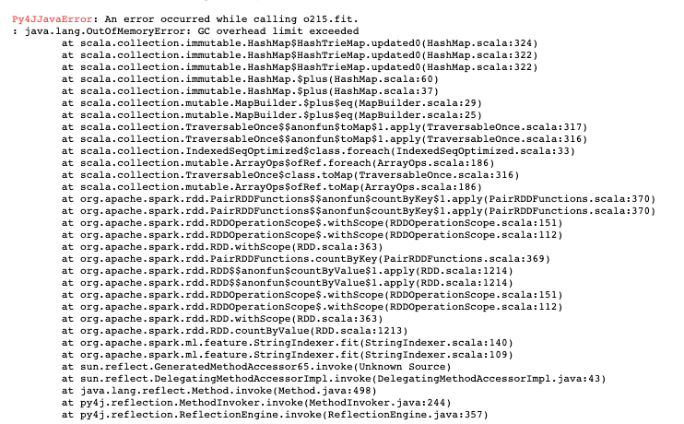
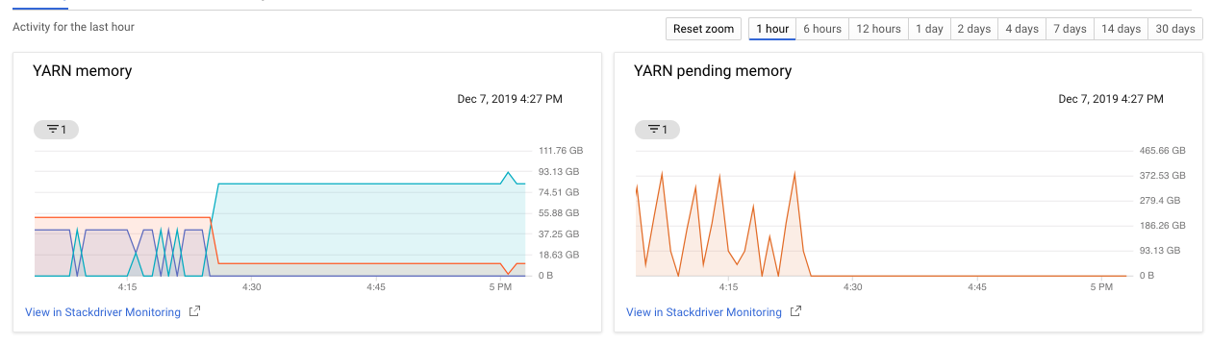
GCP is powerful but ...
Spin up a cluster with enough memory
We completely underestimated the amount of calculation involved in the full dataset. The consequence is all sorts of trials and errors.

Slide 32
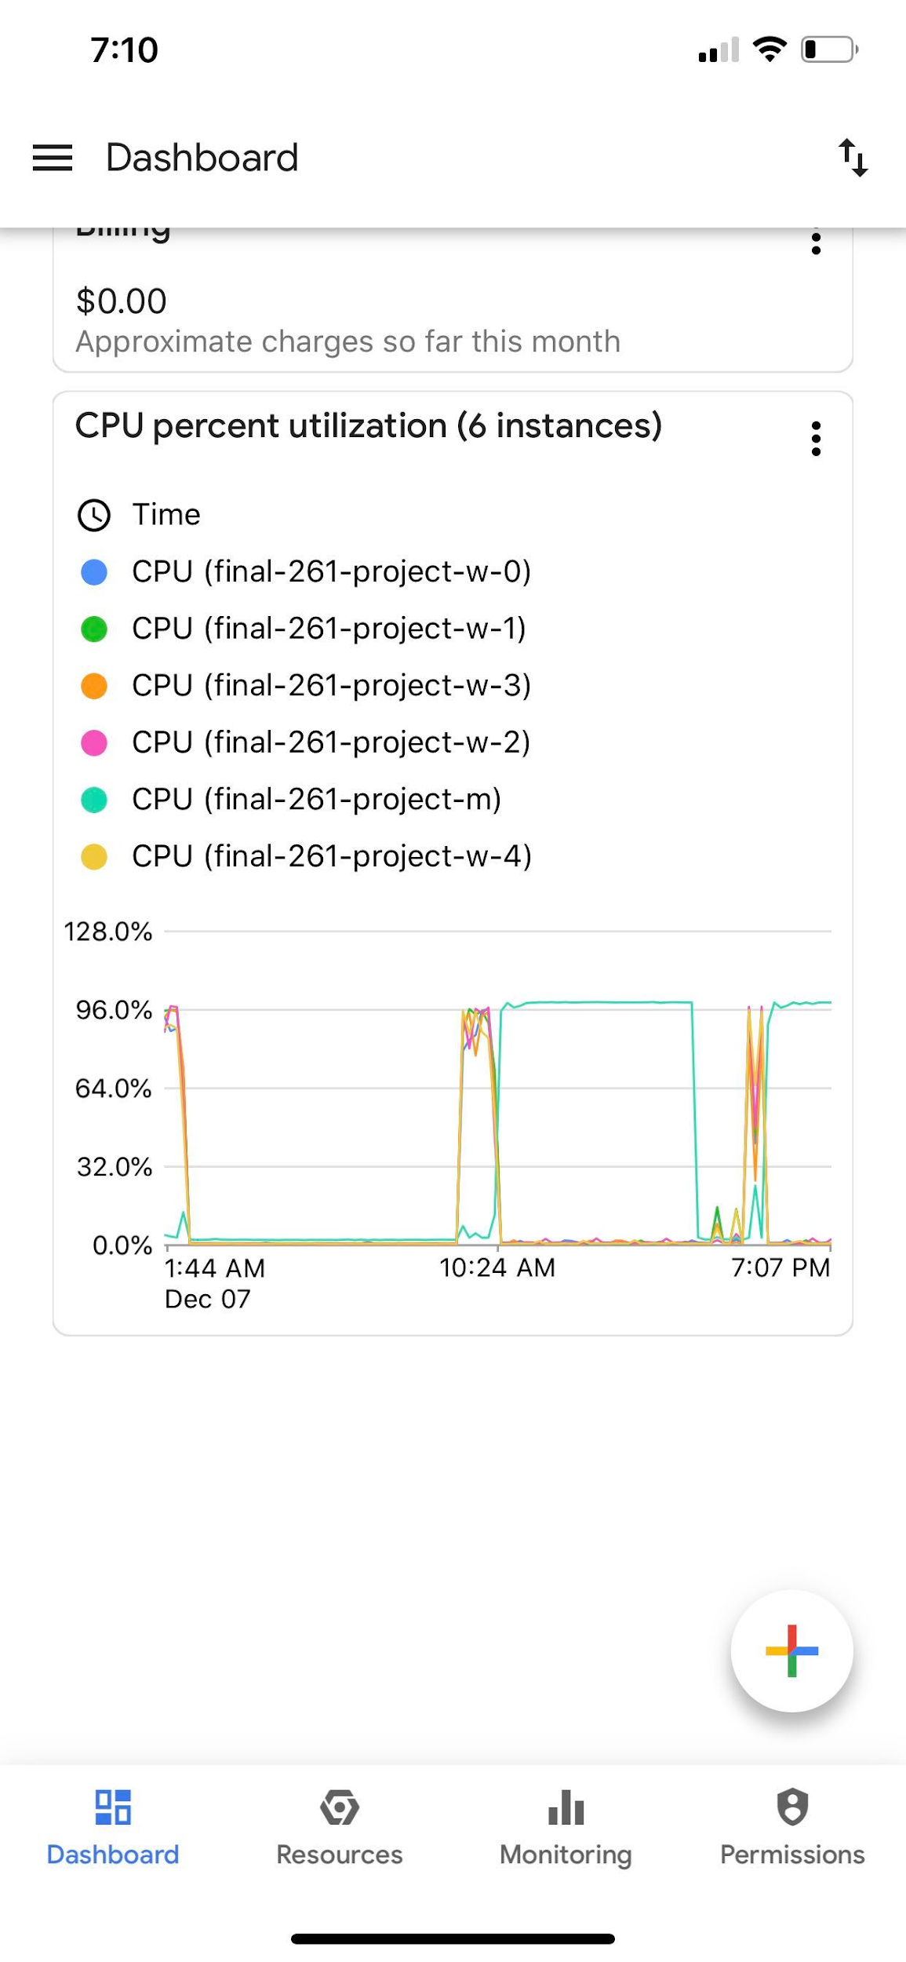
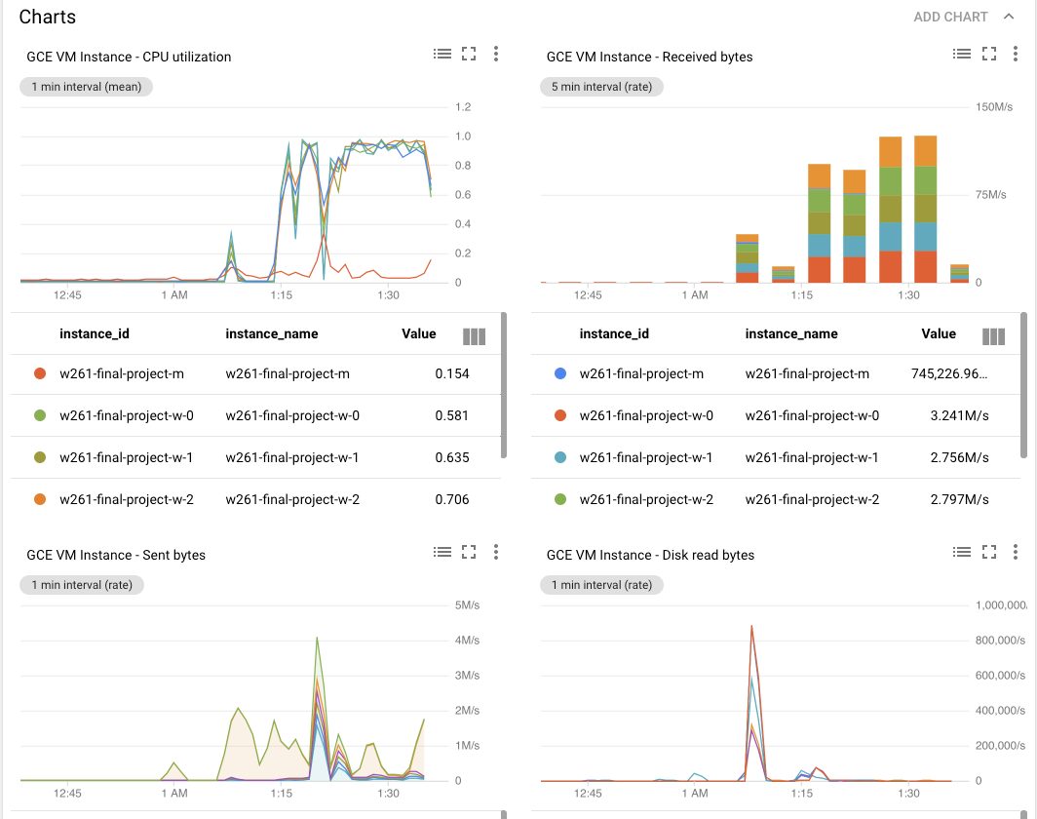
GCP works in mysterious ways ...
It would have been nice to understand how GCP works
How master assigns jobs to workers
Which jobs are performed by master node
Which jobs are performed by workers

Slide 33
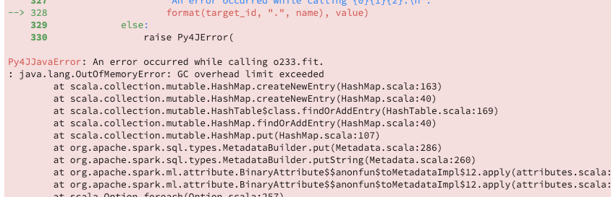
GCP error message is a mercy ...
So happy to see an error message
Many time, it stopped working without any message
Kernel dead without warning
Kept running without no result

Slide 34
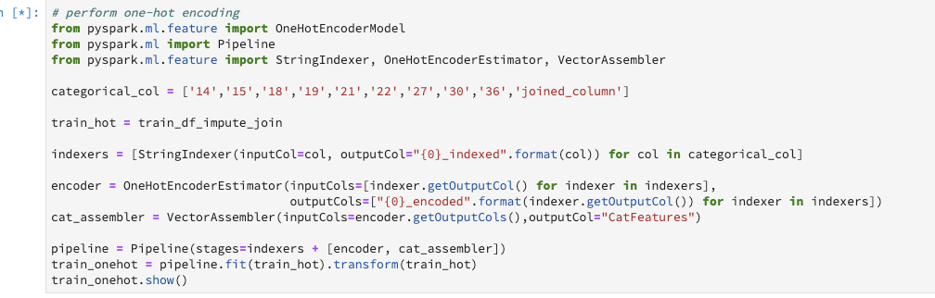
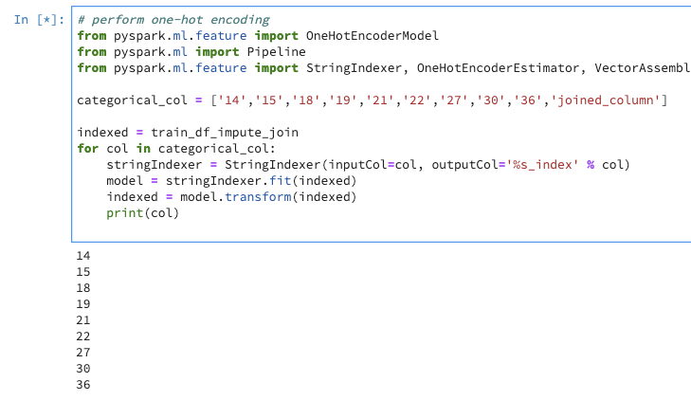
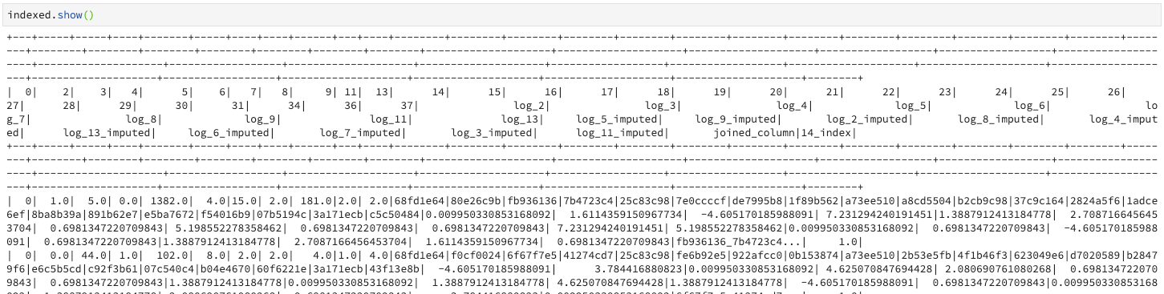
GCP needs dissection ...
It is hard to diagnose where the issue happened
Running a notebook made it easier to run step by step
Dissecting the process helped us figure out where needed fixes
StringIndexer was the problem
Notes:
Doing the stringindexer one column at a time to find out which one fails.

Slide 35
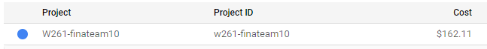
GCP can get expensive ...
This is even truer if you don’t know what you are doing
Due to the issues above, it cost us sometimes 50 dollars to get nothing out of the process
It cost us 160 dollars for this project
Final run
Total
The 50 dollar one
Notes:
Doing the stringindexer one column at a time to find out which one fails.

Slide 36

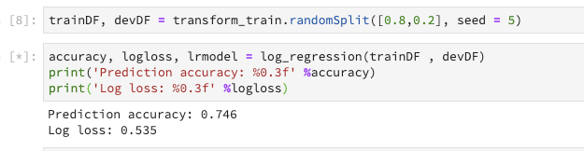
GCP can be magical ...
Finally, we were able to get it done
It was not without tears and frustrations
Christmastime is here
—or as we like to call it, the most wonderful time of the year.
Notes:
Doing the stringindexer one column at a time to find out which one fails.

